Slide 1
TEST
Testing men who have sex with men in Vietnam
Doan Thanh Tung
Lighthouse Social Enterprise

Slide 2


One and only choice before 2015
Annual HIV testing uptake

Slide 3

Community role in HIV testing before 2015
OUTREACHING
REFERRING
RISK ASSESSING

Slide 4
Challenges
Increasing HIV prevalence among key populations
Variable capacity within communities
Incomplete HIV testing laws and policies
High stigma and discrimination in healthcare settings towards men who have sex with men
Service inequity, particularly in rural areas

Slide 5
Now, we changed
OUTREACHING
COUNSELING
COLLABORATING
PROVIDING SERVICES

Slide 6




Testing men who have sex with men in Vietnam
 | Mobilization | Testing | Linkage
 | Outreach: Daily Group: Monthly Event: Quarterly, Yearly | Healthcare facility: Daily Community: Daily Mobile: Monthly/quarterly Home | Same day linkage Flexible as required and needed
 | Social media Hotspots Community events Mass media | Healthcare facility Community Mobile Self-test/Home | Private clinic Outpatient Clinic Hospital
 | Community Peer Influencer Healthcare workers Partner | Healthcare worker Lay tester/Peer Self-test Partner | Peer Lay tester Healthcare worker Partner
 | Online activities (Post, video, campaign, game etc.) Meetings, events Marketing, Viral products | Rapid finger or oral HIV test STI and HCV test Venous Blood test Pre, post and follow up Counseling | ART and care PrEP, nPEP Psychological counseling Harm reduction STI service

Slide 7
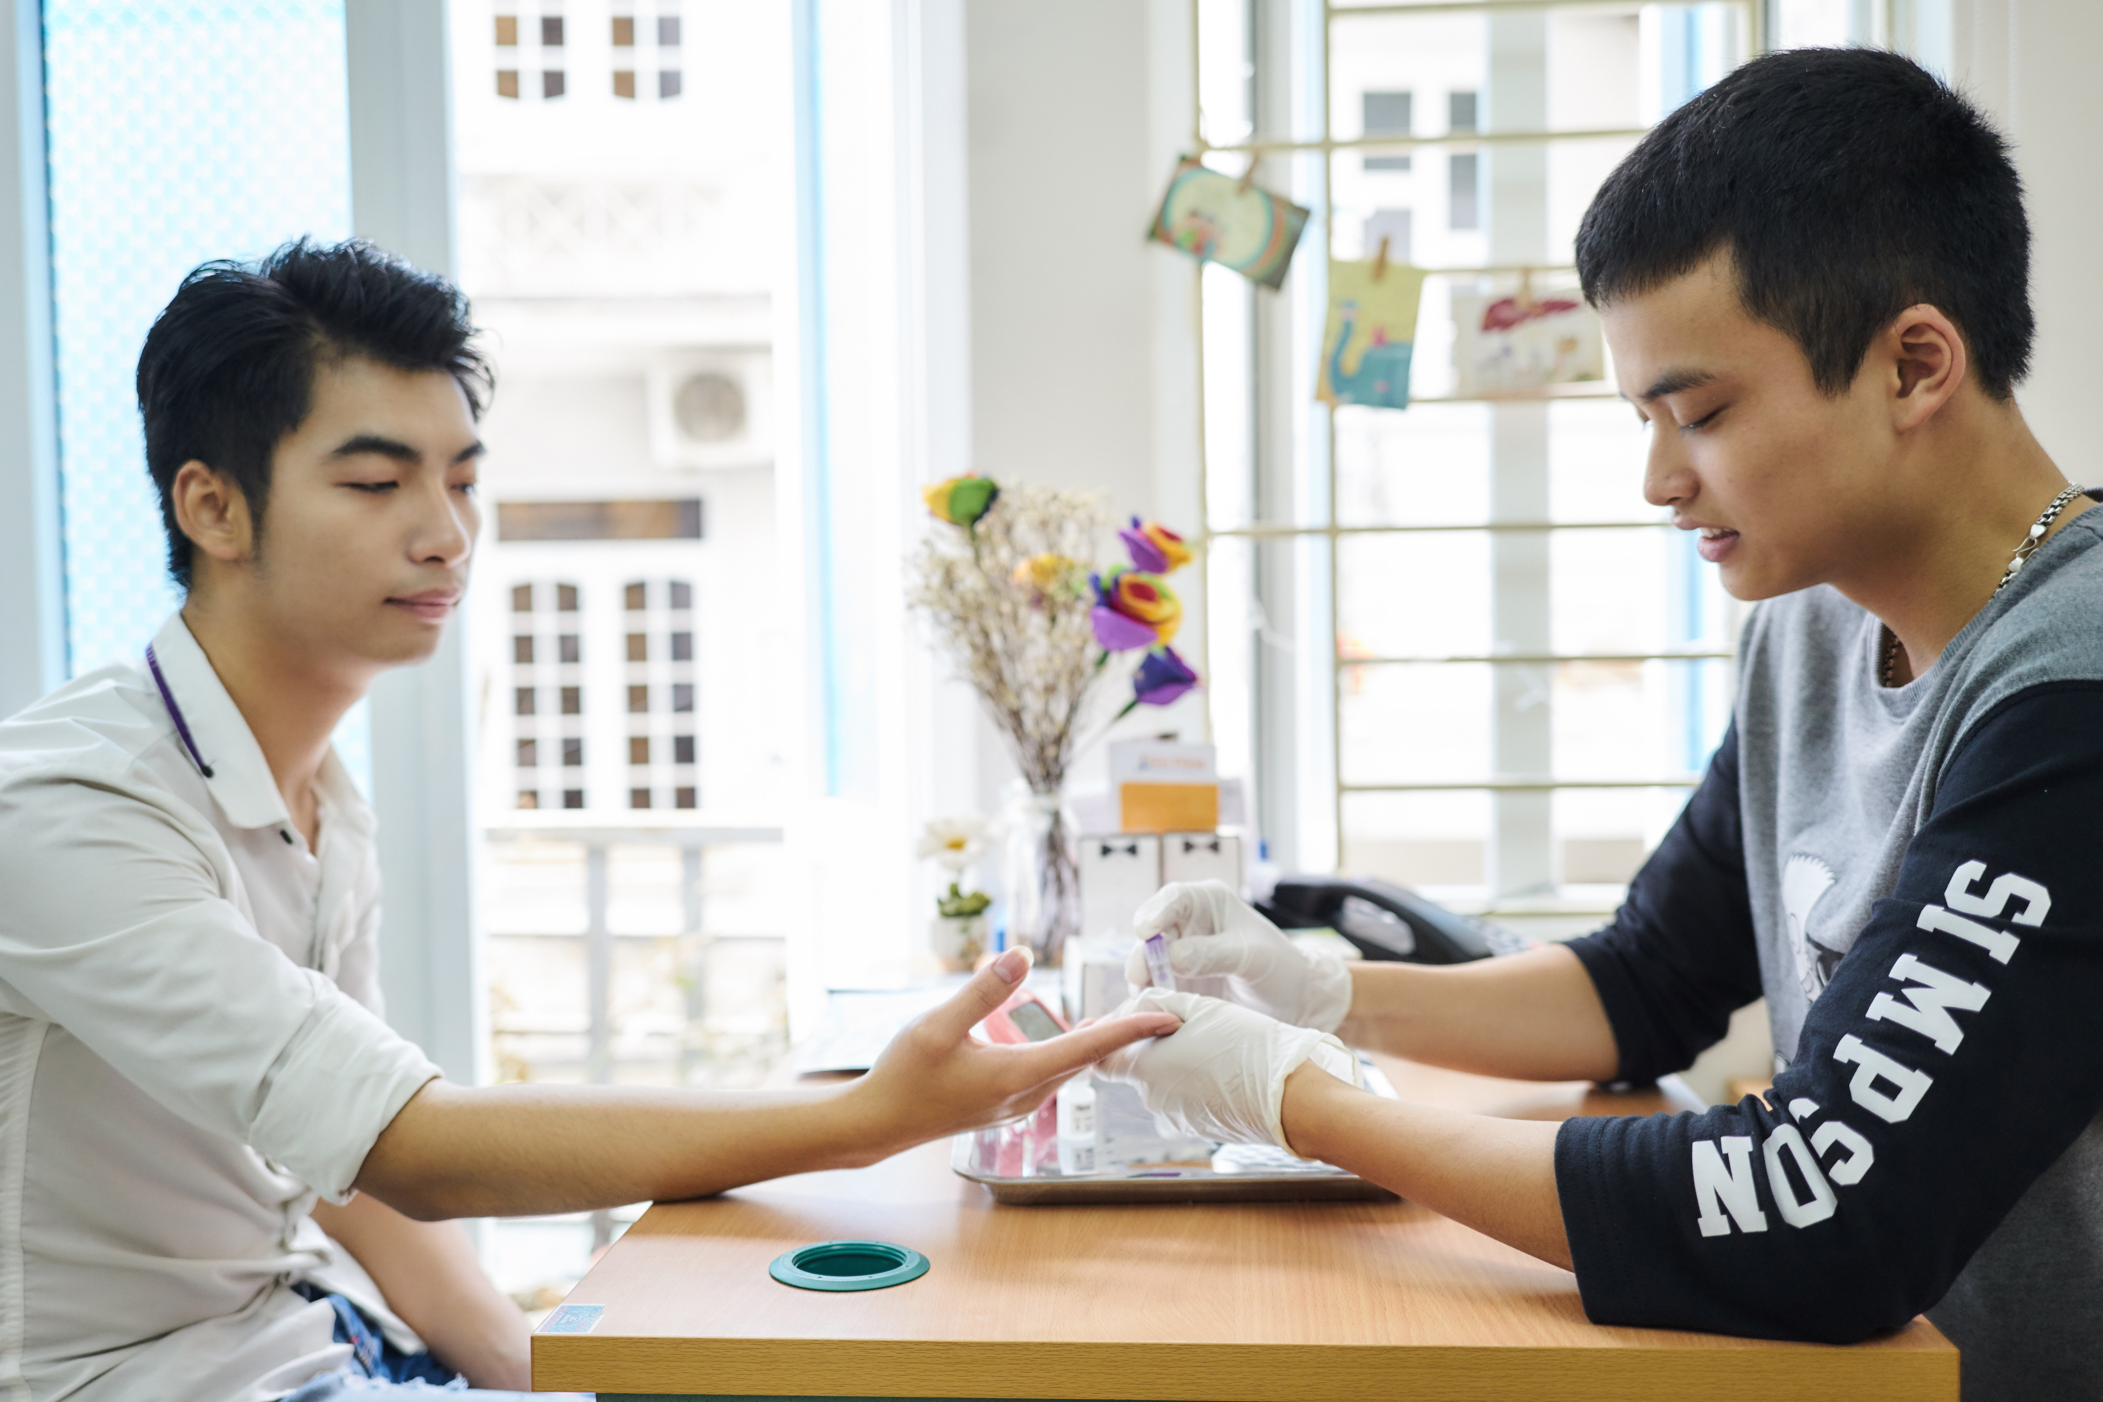
Lay tester performs HIV testing
“Testing at Lighthouse is very convenient and comfortable because I can easily book an appointment, the working times are flexible and they understand me”. (H, MSM in Hanoi)

Slide 8
Reaching men with ART
 | ART refills | Clinical consultations | Psychosocial support
WHEN | Same day register Monthly | Each time client coming for ARV Flexible as needed | As required and needed
WHERE | Private clinic OPC Hospital Home delivery Register mail | Hospital OPC Online On phone | Hospital OPC Online On phone Zalo/fb
WHO | Pharmacists Doctors Nurse Peer/ care supporter | Clinical counselor Doctor Pharmacists | Clinical counselor Trained peer
WHAT | ART Initiation/refills with some flexibility (delivered to home, by mail, every 2-3 months in select cases) | ART Initiation/refills Adherence support OI counseling Psychological support Partner notification | Mental health Sexual health Adherence Community networking Reintegration into the community

Slide 9
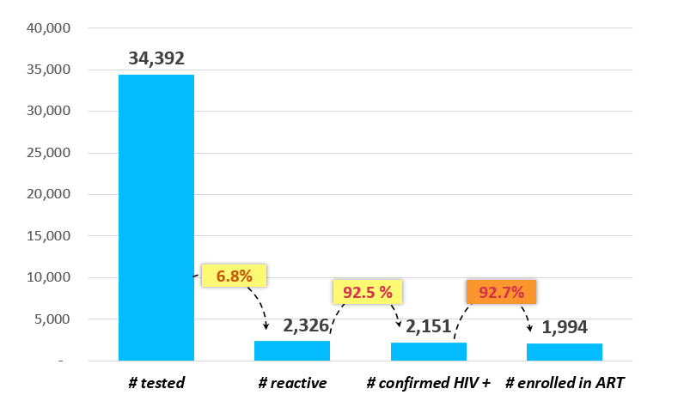
HIV lay testing cascade among MSM (HCMC/Hanoi: Jan 2016 – May 2018)
Source: USAID/PATH Healthy Markets and partners: MER reports 2016-2018

Slide 10
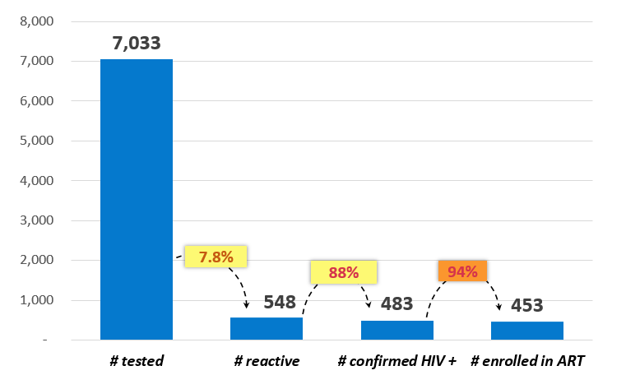
HIVVV
MSM HIV self-testing cascade
(HCMC/Hanoi: Jan 2016 – May 2018)
Source: USAID/PATH Healthy Markets and partners: MER reports 2016-2018

Slide 11
Lesson learned and next steps
Offering KP-led services are generating community demand and increasing HIV service uptake in Vietnam
The community now has the right to choose and access multiple services, services need to be equitably accessible
Financing needed to sustain community-based organization (CBO) efforts and for community-based innovation

Slide 12

Giving heart – Stop AIDS Together

